Slide 1
Pub/Sub Open Issues
Steven Lai

Slide 2
Overview
Event Definition
Event Decomposition
Subscription Dissemination

Slide 3
Event Description Module
Provide High-level application specific event definition language to define and subscribe to high-level events (e.g. ITS, SHM)
Some application specific modules will decompose the high-level events to low-level events
The translation scheme must be validated so that the decomposition will not change the semantics of the events.

Slide 4
Event Description Language Examples
Collision event in ITS:
  The distance between two vehicle is below certain threshold.
  Users need to give parameters such as the threshold value, speeds.
Events in the middleware:
  Car events: detect the presence of car
  Speed events: composite events from car events which can detect the speed of the car
  Collision event: events composed from car events and speed events.

Slide 5
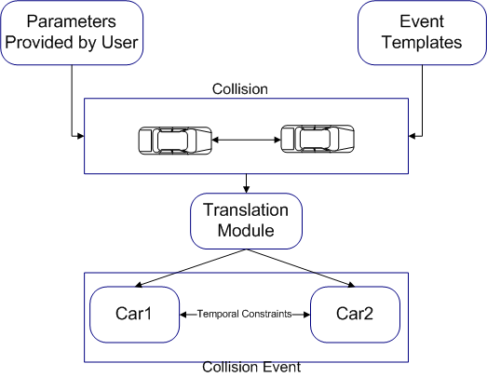
Components

Slide 6
Event Decomposition Module
Translate the events to data structures which can be easily evaluated by the network
Use an evaluation tree to express the relations between composite event and sub-events.
Use a spatial-temporal graph to represent the relations among the events

Slide 7
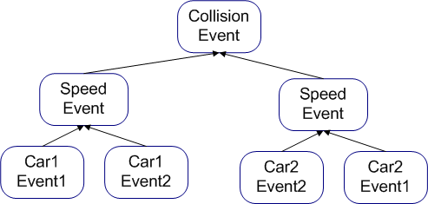
Event Evaluation Tree
Evaluation Tree for Collision Event

Slide 8
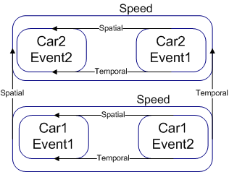
Event Graph

Slide 9
Event Dissemination
Disseminate the subscription as tasks to be executed by the sensor nodes
Nodes will need to decide among themselves on which event to detect.
How to decide:
  Based on their own capability and their neighbors’ (location, sensor, etc)
  Based on the event semantics

Slide 10
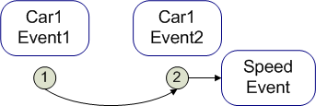
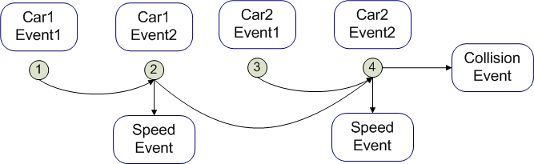
Event Dissemination
Examples

